Slide 1

The Pulse of Business
Statistics & Distribution
Mastering Uncertainty, Using the Laws of Probability to Manage Business Risk
WEEK 6
01 / 30

Slide 2
Section 1 • The Flaw of Averages
why distributions matter more than means?
“
One foot in a bucket of ice.
One foot in a fire.
On average, you are comfortable.
In business, the average hides the danger. We need to look at the Distribution to see if our feet are freezing or burning.
We have moved from reporting the past to understanding the mathematical laws that govern the present. This week is about "The Pulse." Just as a doctor uses a heart rate to check health, an analyst uses Distribution to check the health of a business process.
02 / 30

Slide 3
THE POWER OF MAYBE
Defining Probability
The likelihood that a specific event will occur
Probability is the only tool that lets us quantify uncertainty
We move from 'I think...' to 'There is a 70% probability that...'
Expressed as a value between 0 (impossible) and 1 (certain)
In business, every forecast, budget, and risk model is built on this foundation
03 / 30

Slide 4
DATA TYPES
Discrete vs. Continuous Data
Discrete
Continuous
Things you COUNT
Things you MEASURE
Number of customers
Weight, time, revenue
Orders per day
Infinite values in any range
Only whole numbers make sense
Determines which model to use
04 / 30

Slide 5
HISTOGRAMS
The Shape of Data
A histogram shows how values are distributed across a range
Look at the symmetry: is it a balanced hill, or is it leaning to one side?
The shape tells you more than any single number ever could
Symmetric = balanced risk. Skewed = hidden danger on one side.
Before running any statistics: always look at the histogram first
05 / 30

Slide 6
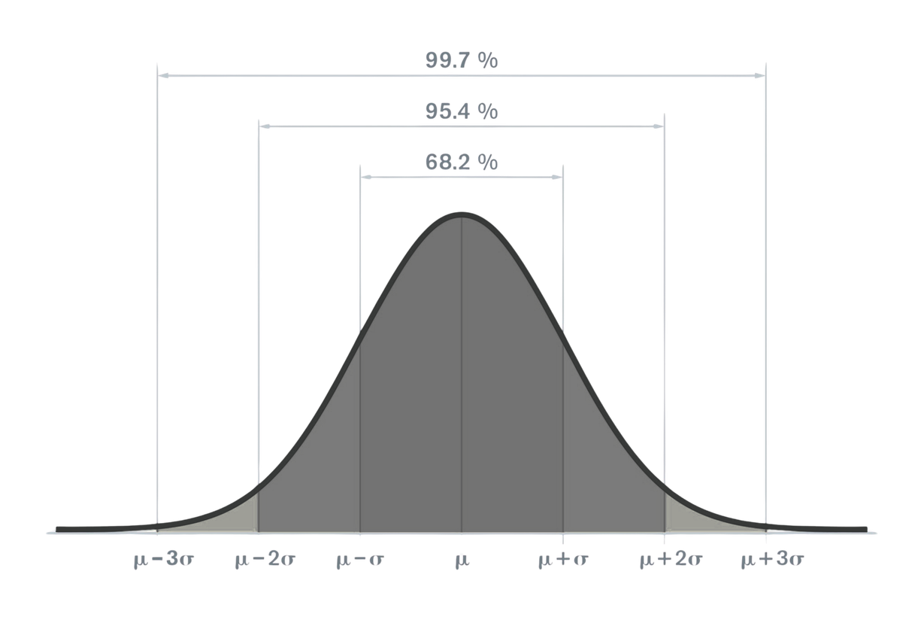
SECTION 2
The Normal
Distribution
The most important shape in the universe
06 / 30

Slide 7
NORMAL DISTRIBUTION
The Empirical Rule: 68 - 95 - 99.7
68% of data falls within 1 Standard Deviation of the mean
95% of data falls within 2 Standard Deviations
Delivery time: mean 3 days, SD 0.5 days, 95% of customers get it in 2 to 4 days
99.7% of data falls within 3 Standard Deviations
Beyond 3 SDs: statistically rare events, but not impossible
07 / 30

Slide 8
NORMAL DISTRIBUTION
Mean & Standard Deviation
The Mean
Standard Deviation
Where the curve is centered
How fat or skinny the curve is
The peak of the bell
Low SD = tall, narrow = consistent
Shifts the curve left or right
High SD = wide, flat = variable
Tells you: where is typical?
Tells you: how reliable is typical?
08 / 30

Slide 9
Z-SCORES
Z-Scores: The Great Equalizer
Z = (x - mean) / standard deviation
Converts any value into a universal 'distance from average' score
Allows you to compare performance across completely different scales
$1M profit in Toys (Z = 3.0) vs $2M profit in Electronics (Z = 0.5)
The Toy manager is the star, their result is 3 SDs above their norm
Z-scores are how we answer: is this result impressive, or expected?
This allows us to compare "Apples to Oranges." Is a $1M profit in the "Toys" department more impressive than a $2M profit in "Electronics"? If the $1M is 3 SDs above the toy average, and the $2M is only 0.5 SDs above electronics, the Toy manager is the star.
09 / 30

Slide 10
SKEWNESS
Skewness: When the Bell Leans
Right-Skewed
Left-Skewed
Long tail pulling right
Long tail pulling left
Mean > Median
Mean < Median
Household income, sales revenue
Exam scores with a hard ceiling
A few huge values drag the average up
A few very low values drag average down
10 / 30

Slide 11
KURTOSIS
The Heavy Tails
Measures how thick the tails of your distribution are
High kurtosis = extreme events happen more often than the normal model predicts
Market crashes, viral product launches, supply chain collapses
A normal model says '3-sigma events' happen 0.3% of the time
High-kurtosis reality says they happen 5-10x more often
This is why financial models built on normal assumptions failed in 2008
11 / 30

Slide 12

CASE STUDY
The Coffee Temperature Case
A coffee shop wants to ensure no one gets burned. The mean temp is 70°C. How do they use Standard Deviation to set a "Safety Limit"?
[68%]
[95%]
[99%]
1 SD Rule
2 SD Rule
3 SD Rule
65 to 73 degrees
covers 68% of
all cups served
64 to 76 degrees
covers 95%.
Use as warning zone.
Above 79 degrees
is the safety cut-off.
Automatic alert fires.
Mean serve temp is 70 degrees C. SD is 3 degrees. Set the safety limit.
12 / 30

Slide 13
VALIDATION
Normal Probability Plots
A diagnostic tool to check if your data actually follows a normal distribution
If points fall close to a straight diagonal line, your data is normal
Curves or S-shapes in the plot reveal skewness or heavy tails
Never apply normal-distribution formulas to non-normal data
In Excel: Analysis ToolPak > Histogram + manually check the shape before proceeding
13 / 30

Slide 14
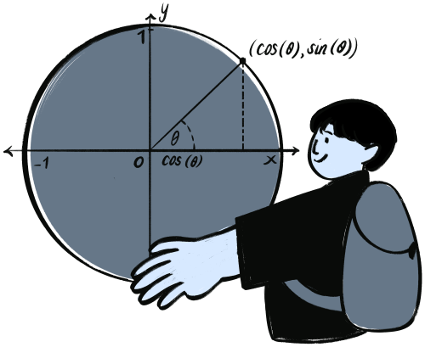
SECTION 3
The Central
Limit Theorem
The most powerful idea in all of statistics
14 / 30

Slide 15
THE CENTRAL LIMIT THEOREM
CLT
No matter what the data looks like, averages of samples are always normally distributed
Messy data. Weird shapes. Doesn't matter. Sample enough, and the bell curve emerges every time.
15 / 30

Slide 16
SAMPLING
Sampling Distribution
You don't need to survey every customer to know what the average customer thinks
Take many random samples, the distribution of those sample means is normal
This is exactly why political polls work with only 1,000 people out of millions
Larger samples produce a tighter, more reliable sampling distribution
The CLT is the mathematical permission slip for all business research
16 / 30

Slide 17
PRECISION
Standard Error vs. Standard Deviation
Standard Deviation
Standard Error
Spread of individual data points
Spread of sample means
How variable is the raw data?
How precise is our estimate?
Describes the population
Describes our sampling accuracy
Does not shrink with more data
Shrinks as sample size increases
17 / 30

Slide 18
CONFIDENCE INTERVALS
Confidence Intervals
'We are 95% confident the true average is between X and Y'
Never give a single-point estimate, always give a range
Professionalism is admitting you might be slightly off
A 95% CI means: if we ran this study 100 times, 95 intervals would contain the truth
Wider interval = more uncertainty. Narrower interval = more data collected.
18 / 30

Slide 19
REAL-WORLD CLT
The CLT in Action
The Exit Poll
The Casino
News calls election before all votes
Loses money on one Blackjack hand
CLT: enough sample = reliable estimate
Over 1 million hands: always wins
Margin of error shrinks with more data
Law of Large Numbers in action
Statistics replaces waiting
Probability only works at scale
19 / 30

Slide 20
LAW OF LARGE NUMBERS
The Law of Large Numbers
As you repeat an event more often, results converge to the expected average
A coin flip: first 10 flips can be 8 heads. After 10,000 flips: nearly 50/50.
Short-run streaks are noise. Long-run patterns are signal.
Business implication: never judge a strategy on a 2-week sample
More data = more certainty. Always ask: how large is the sample?
20 / 30

Slide 21
EXCEL PRO MODE
Excel's Analysis ToolPak
File > Options > Add-ins > Analysis ToolPak > Go > Enable
Data > Data Analysis button now appears, this is Pro Mode
Generates mean, SD, confidence interval, skewness, kurtosis in one click
Tools: Descriptive Statistics, Histogram, Regression, Sampling
Use Descriptive Statistics on every new dataset before doing anything else
21 / 30

Slide 22
EXCEL FUNCTIONS
NORM.DIST vs. NORM.INV
NORM.DIST
NORM.INV
Given a value, find the probability
Given a probability, find the value
What % of deliveries take < 4 days?
What is the top 5% sales threshold?
=NORM.DIST(value, mean, SD, TRUE)
=NORM.INV(probability, mean, SD)
Input: a data point
Input: a percentile
22 / 30

Slide 23

YOUR SOFT SKILL FOR THIS WEEK
CRITICAL THINKING
Statistics are a map, don't follow the map into a cliff
23 / 30

Slide 24
CRITICAL THINKING
Correlation is NOT Causation (Again)
Sunblock sales and ice cream sales are highly correlated
Does sunblock cause ice cream hunger? No, the sun is the hidden variable
Statistics find the link. Humans find the logic.
Every spurious correlation has a story that sounds plausible, until you think
Your job: never report a correlation without investigating the mechanism behind it
24 / 30

Slide 25
ETHICS
The Ethics of Outlier Removal
Deleting low-end outliers to make the average look better is fraud
Always report the reason for any data removal, document it in the cleaning log
If you can't explain why you removed it, you should not have removed it
A removed outlier that is never mentioned is a lie of omission
The audience trusts the analyst to show the full picture, not the flattering one
25 / 30

Slide 26
TAIL RISK
The Black Swan
Events the Bell Curve calls impossible, that happen anyway
The 2008 Financial Crisis: models said it was a 25-sigma event, impossible by definition
It happened. The model was wrong. The territory disagreed with the map.
High kurtosis distributions produce black swans far more often than normal models predict
Always ask: what does the model assume cannot happen?
26 / 30

Slide 27
JUDGMENT
Over-Reliance on Data
Analysis Paralysis
Informed Courage
Waiting for more data before deciding
Use stats to reduce risk, not remove it
Stats say: wait for significance
Sometimes opportunity says 'Go'
Competitor moves while you analyze
Data informs the decision
Perfect data never arrives
The human makes the decision
27 / 30

Slide 28
SOFT SKILL
Communicating Statistics to Non-Stats People
Don't say: 'The Z-score is 2.5 and the p-value is 0.012'
Do say: 'This result is very unusual, it happens less than 1% of the time'
Translate every statistic into a business sentence before presenting it
Don't say: 'The 95% CI is 42.3 to 47.8'
Do say: 'We're confident the true average is somewhere between 42 and 48'
28 / 30

Slide 29
SUMMARY
What We Covered This Week
Probability, the language of uncertainty, quantified
Normal Distribution, the shape of most business phenomena
Empirical Rule, 68, 95, 99.7 and what they mean operationally
CLT, Z-Scores, Confidence Intervals, the analyst's statistical toolkit
29 / 30

Slide 30

Let's Talk.
Statistical thinking will one day be as necessary as the ability to read and write. H.G. Wells
Lab: 'Quality Control Audit' use the math to tell the factory if the machines are failing.
Next week: Regression & Prediction.
30 / 30

